Slide 1



Blablacar Case
From data to Business

Slide 2
Index
Presentation
Case Context
From Data to Business
Working with Geo Data
Building a Shiny App
Taking Blablacar to the next level

Slide 3
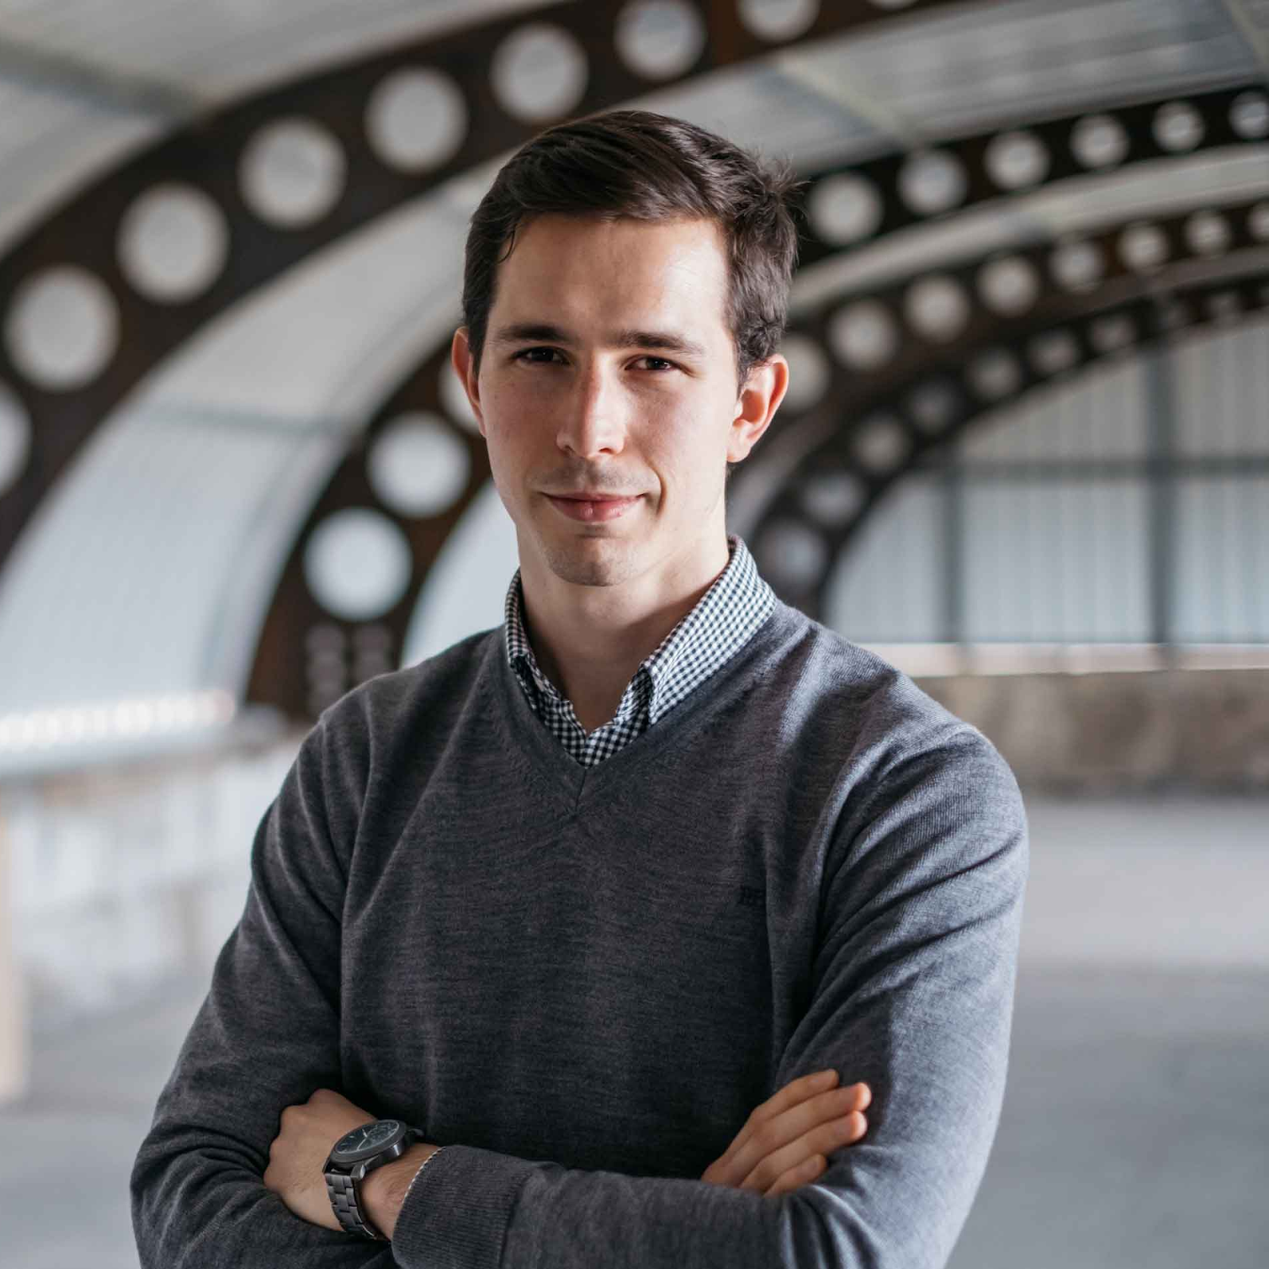
Ander Fernández
Business Administration Graduate at Deusto Business School.
Studied Big Data & Business Intelligence Program (2019-2020)
I work as Data Scientist at LIN3S.
Winner of the UniversityHack 2020.
1.5 years ago I didn’t know how to code.
anderfernandezj@gmail.com
anderfernandez.com/blog/

Slide 4





















Clients at LIN3S

Slide 5
Index
Presentation
Case Context
From Data to Business
Working with Geo Data
Building a Shiny App
Taking Blablacar to the next level

Slide 6
Context
Blablacar is a French company dedicated to facilitating car sharing established in Spain since 2010.
Blablacar wants to explot the data generated with journey offers and demand to improve the business of the company.
For this, Blablacar has provided us with the following information (see next page)

Slide 7
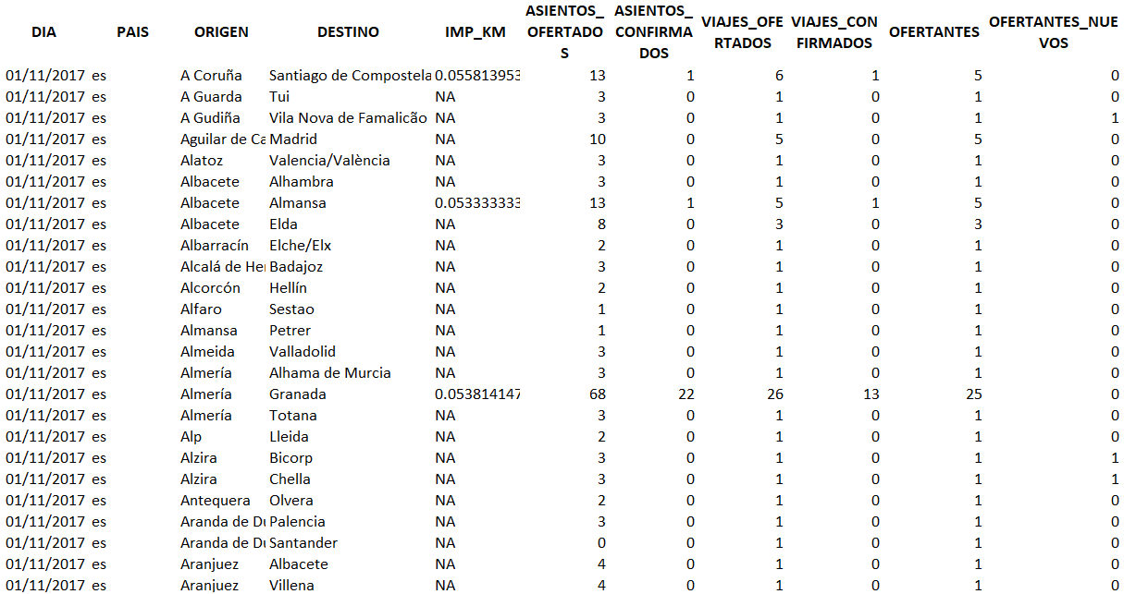
Context - Data

Slide 8
EDA main results
There are a lot of route with high offer and low demand.
Both offer and demand are not equally distributed among all weekdays.
Trips occurring in a constant bases are more likely to be covered that those than are spontaneous.
Not all provinces are equal: some have several important cities with large amount of travels while others concentrate most travels in one or two cities.

Slide 9
What information could we add to the one that we already have?

Slide 10
Data enrichment
Date-related data:
Basic Data: day of the week, month, week, year...
External Data: Hollydays, Holliday eves…
Trip Data:
Population: province, Comunidad Autónoma, inhabitants…
Geo: Coordinates, geometries
Trips: distance, time...
New calculated data
Route probability: total, by day, by day type
Relative data: %confirmed trips, etc

Slide 11
Index
Presentation
Case Context
From Data to Business
Working with Geo Data
Building a Shiny App
Taking Blablacar to the next level

Slide 12
Know that we know what we have…

Slide 13
Know that we know what we have…
¿What can we do to improve Blablacar’s business with this data?

Slide 14
How can we earn more money?
Earn more money

Slide 15
How can we earn more money?
Increase Income
Earn more money
Reduce Costs

Slide 16
How can we earn more money?
Increase Income
Earn more money
Reduce Costs
Note: Blablacar’s business model is to charge a 10-15% comission for each trip.

Slide 17
How can we earn more money?
More Trips
Increase Income
Longer Trips
Earn more money
Reduce Costs
Note: Blablacar’s business model is to charge a 10-15% comission for each trip.

Slide 18
How can we earn more money?
Same people, more trips
More Trips
Increase Income
More people, same trips/person
Longer Trips
Earn more money
Reduce Costs
Note: Blablacar’s business model is to charge a 10-15% comission for each trip.

Slide 19
Why do people don’t use Blablacar?

Slide 20
Why do people don’t use Blablacar?
Safety
There is not the route that I want
I can't plan the trip
I’ve never think about it
Price
I’m a shameful person

Slide 21
All problem has a solution
Problem | Solution
There is not the route that I want | Expand routes by creating connections to be able to go further.
I can't plan the trip | Obtain the probability of a trip on a given day.
I’ve never think about it | Know the penetration of Blablacar by localities to know strong and weak regions.

Slide 22
Our Idea
Ir más lejos: a new service that (1) predicts the probability of that trip to happen and (2) finds a short and highly probable alternative.

Slide 23
Our Idea
Ir más lejos: a new service that (1) predicts the probability of that trip to happen and (2) finds a short and highly probable alternative.
Ir a más gente: a responsive dashboard showing the use of Blablacar in different provinces and the municipalities within this provinces.

Slide 24
Our Idea
Ir más lejos: a new service that (1) predicts the probability of that trip to happen and (2) finds a short and highly probable alternative.
Ir a más gente: a responsive dashboard showing the use of Blablacar in different provinces and the municipalities within this provinces.
Cuidando el planeta: a dashboard showing the saving in the environmental impact thanks to Blablacar in each municipality.

Slide 25
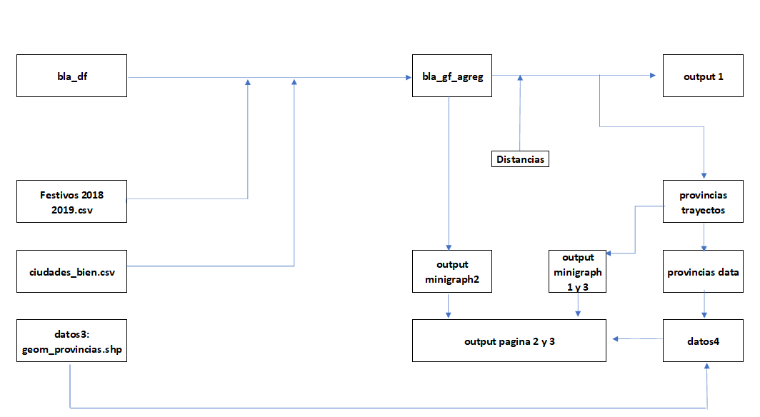
Flujo de datos
Origen
Df objetivo
Datos externos

Slide 26
Index
Presentation
Case Context
From Data to Business
Working with Geo Data
Building a Shiny App
Taking Blablacar to the next level

Slide 27
What data do we need?
In our case we decided to show:
The chosen route: it has a high visual impact and it is vital to differenciate between the direct route and the alternative route.
Provinces: it offers a high visual impact with a low storage cost. We could show municipality data with normal graphs.

Slide 28
Working with Cartociudad
library(caRtociudad)
We will use the following functions:
cartociudad_geocode: enables to retrieve geospatial data given a string.
cartociudad_get_route: enables to extract a route given two coordinates.

Slide 29
Visualizing maps with Leaflet
library(leaflet)
Leaflet allows you to create maps using layers, like ggplot. In this way, we will put the route on the map and include a world map and the names of the cities to see the data well.
In addition, it is a very widespread library that is also used in Python and Javascript. This makes it a library with many interesting options in Shiny.

Slide 30
Index
Presentation
Case Context
From Data to Business
Working with Geo Data
Building a Shiny App
Taking Blablacar to the next level

Slide 31
Shiny
Shinyapps if a perfect toot for this case because:
Enables to show data in a very visual and interactive way. Besides, it enables to include designs and functionalities via HTML, CSS & Javascript.
Enable to run any algorith or code built in R, opening a lot of possibilities.
Putting the app in production with Shinyapps.io is easy and free.
Enlace: https://datmen.shinyapps.io/Datmen/

Slide 32
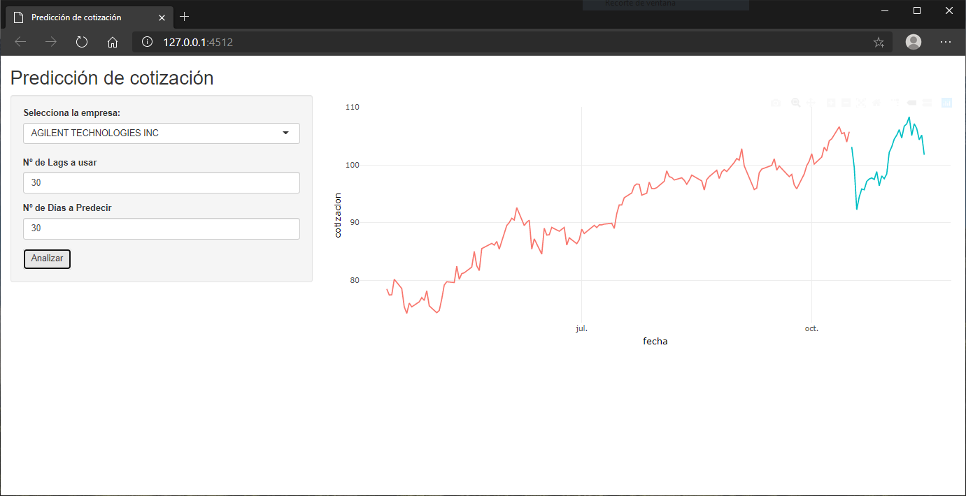

Shiny allows you to create and publish web applications that run R code with which any user can interact

Slide 33
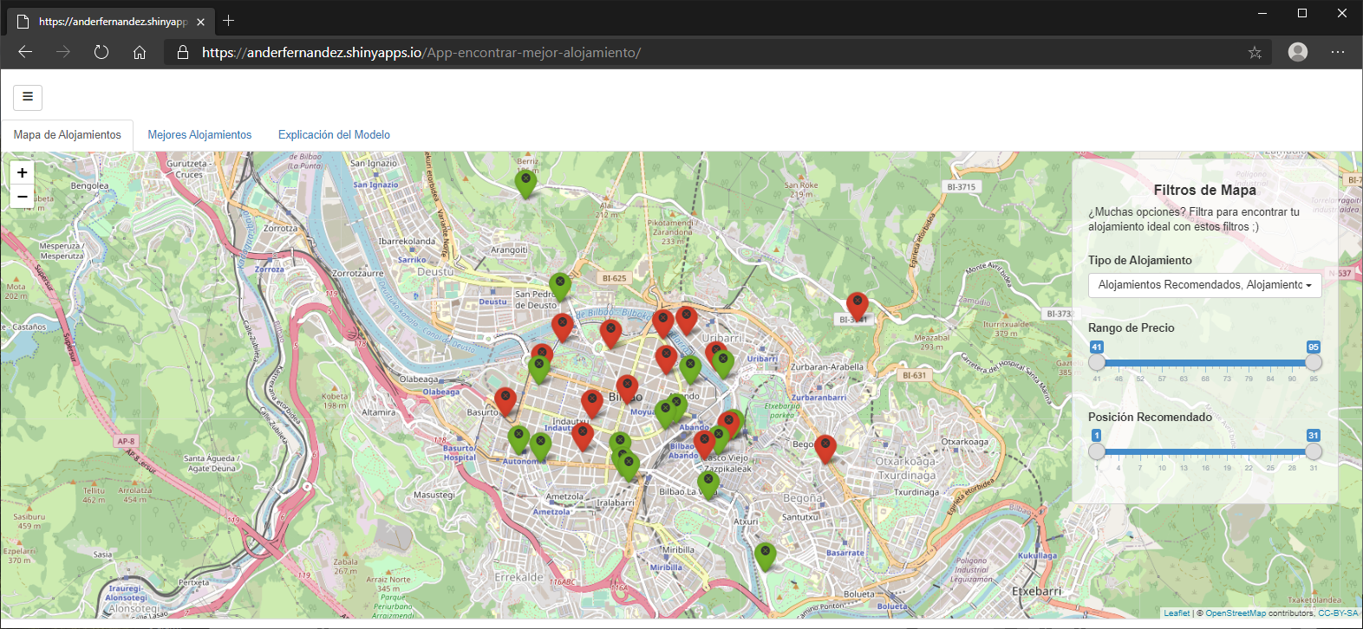
With a single language we can create applications that extract the data through APIs, scraping or access to databases to train and visualize Machine Learning models

Slide 34
App Structure
Initial Part
In this part we load the libraries and data that remain static from the loading of the App.
library(shiny)

Slide 35
App Structure
Initial Part
In this part we load the libraries and data that remain static from the loading of the App.
User Interface
In this part we will create the HTML structure of the page, including: action buttons, sliders, selectors, and everything that the user can enter and that we are going to use on the page.
library(shiny)
ui <- fluidPage(
titlePanel(“Hello World!")
)

Slide 36
App Structure
Initial Part
In this part we load the libraries and data that remain static from the loading of the App.
User Interface
In this part we will create the HTML structure of the page, including: action buttons, sliders, selectors, and everything that the user can enter and that we are going to use on the page.
Server
This is where we run the code in R and generate dynamic results and charts that will be displayed in the UI section.
library(shiny)
ui <- fluidPage(
titlePanel(“Hello World!")
)
server <- function(input, output) {
}

Slide 37
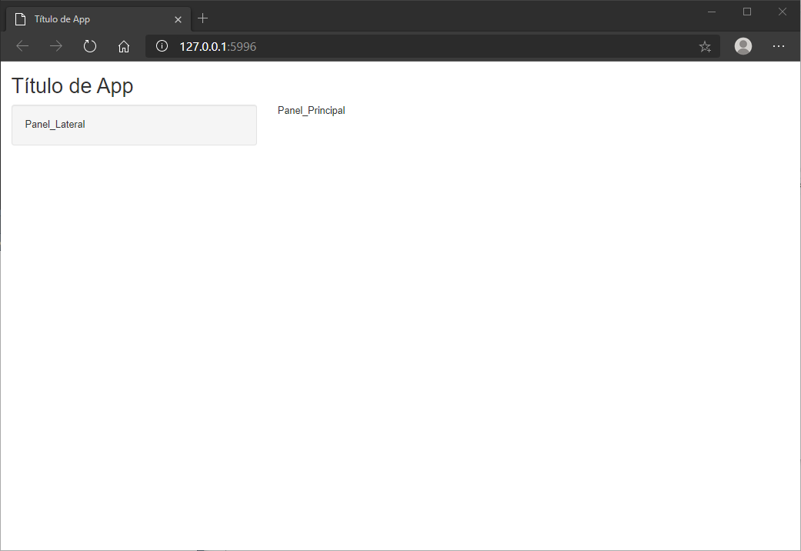
Creating the UI
Although we could create the structure we want or even load an HTML document, Shiny offers functions with basic structures.
Example:
ui <- fluidPage(
titlePanel('Título de App'),
sidebarLayout(
sidebarPanel('Panel_Lateral'),
mainPanel('Panel_Principal')
)
)

Slide 38
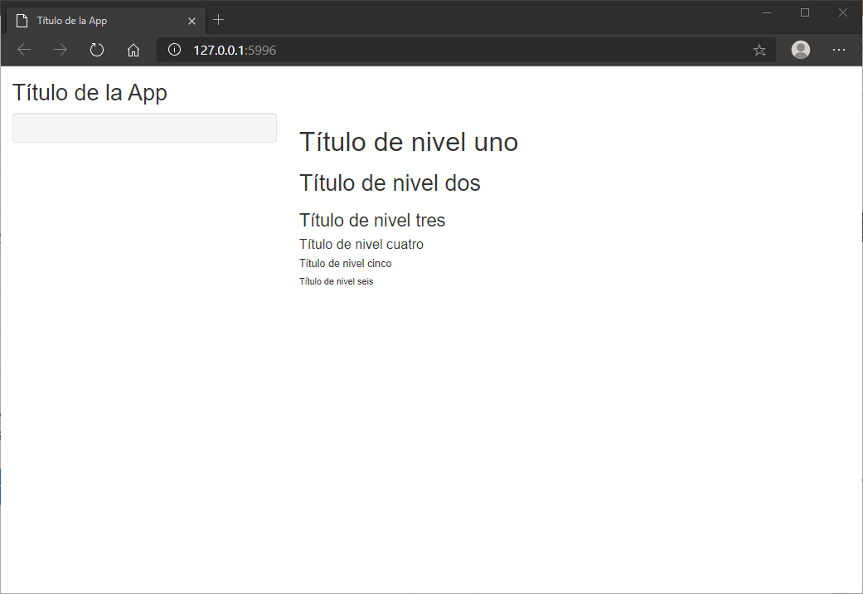
Creating the UI
In addition, in case we do not know about HTML, it offers many functions that allow you to create the UI in HTML5 directly from R.
Example:
ui <- fluidPage(
titlePanel("Título de la App"),
sidebarLayout(
sidebarPanel(),
mainPanel(
h1("Título de nivel uno"),
h2("Título de nivel dos"),
h3("Título de nivel tres"),
h4("Título de nivel cuatro"),
h5("Título de nivel cinco"),
h6("Título de nivel seis")
)))

Slide 39
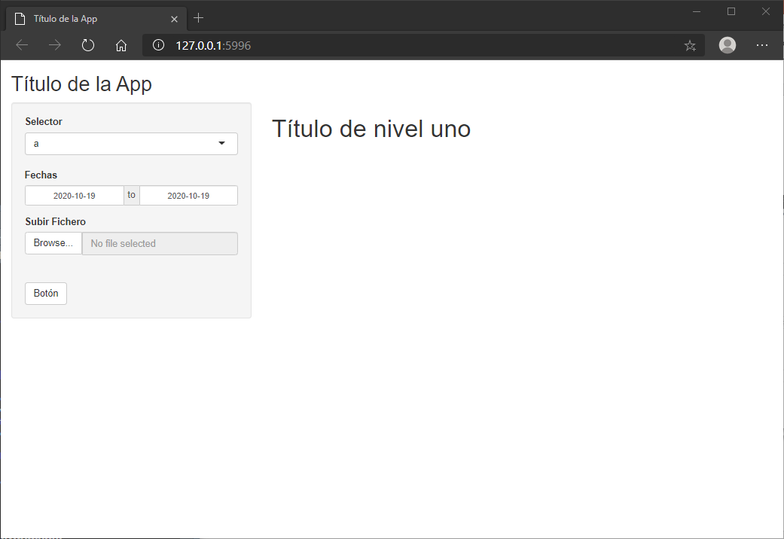
Creating the UI
Likewise, we can also create elements that serve as user inputs, such as: an action button, a selector
Example:
ui <- fluidPage(
titlePanel("Título de la App"),
sidebarLayout(
sidebarPanel(
selectInput("a","Selector",letters),
dateRangeInput("b","Fechas"),
fileInput("c","Subir Fichero"),
actionButton("d","Botón")
),
mainPanel(
h1("Título de nivel uno")
)

Slide 40
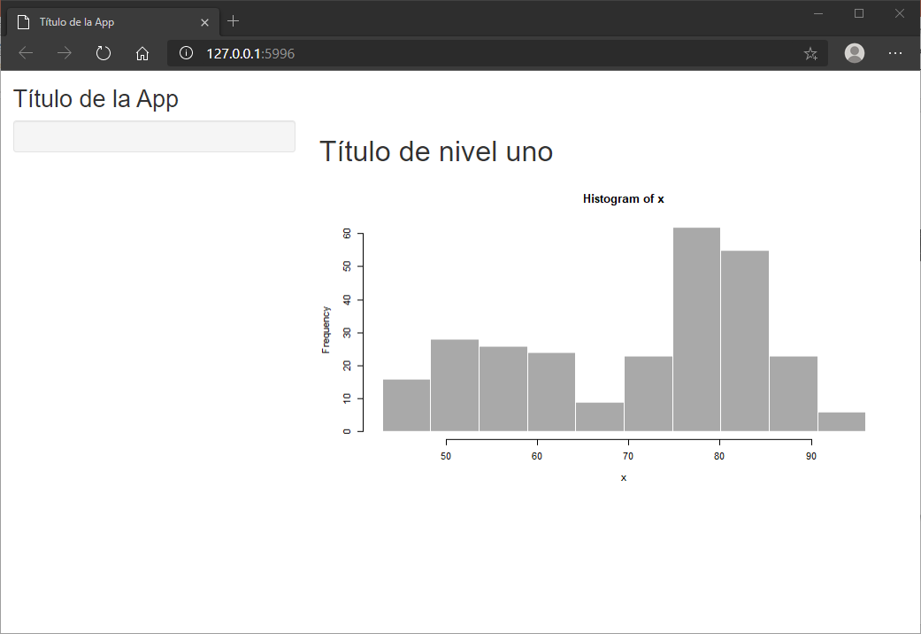
Creating the UI
Finally, we have to indicate where the elements that we create on the server will go. We will do this with the Output functions:
Example:
ui <- fluidPage(
titlePanel("Título de la App"),
sidebarLayout(
sidebarPanel(),
mainPanel(
h1("Título de nivel uno"),
plotOutput("distPlot")
)
)
)

Slide 41
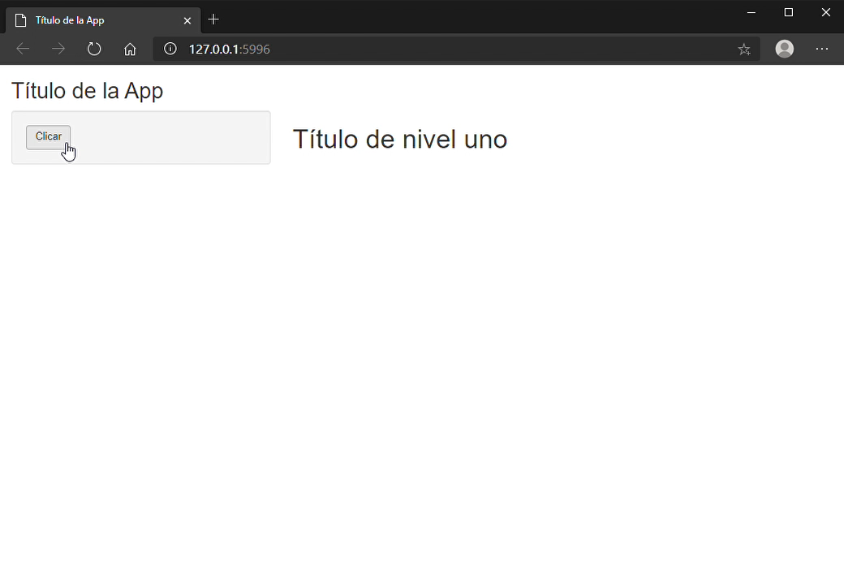
Creating the Server
Reactive elements: They are elements that are updated every time there is any change in the UI or other reactive element or when an element that we indicate changes.
datos = eventReactive(input$accion,{
x = sample(50)
})
Render Elements: consists of rendering an element that we will later show in the UI. In the previous case, if when we used plotOutput a graph was displayed, it is because that graph had been rendered on the server.
output$texto = renderText(
datos()
)

Slide 42
Code of the previous example
library(shiny)
ui <- fluidPage(
titlePanel("Título de la App"),
sidebarLayout(
sidebarPanel(
actionButton("accion","Clicar")
),
mainPanel(
h1("Título de nivel uno"),
textOutput("texto")
)
)
)
server <- function(input, output) {
datos = eventReactive(input$accion,{
x = sample(50)
})
output$texto = renderText(
datos()
)
shinyApp(ui = ui, server = server)

Slide 43
Let’s build an app

Slide 44
Structure of the App
Initial Part
We install caRtociudad.
We load the libraries.
UI
We create a sidebar with a text input and an action button.
We include the output of the visualization that we will build.
Server
We extract the geodata of the input we have included.
We create and render a map with this info.

Slide 45
Structure of the App
Initial Part
We install caRtociudad.
We load the libraries.
# Install caRtociudad
library("devtools")
devtools::install_github("rOpenSpain/caRtociudad")
# Load libraries
library(caRtociudad)
library(leaflet)
library(sf)
library(geojsonio)
library(googleway)
library(shiny)

Slide 46
Structure of the App
UI
We create a sidebar with a text input and an action button.
We include the output of the map that we will build.
ui <- fluidPage(
titlePanel("Visualiza tu localidad"),
# Sidebar with text input and action button
sidebarLayout(
sidebarPanel(
textInput("localidad", "Elige tu localidad:"),
actionButton("boton",label = "Analizar")
),
# Render de Map
mainPanel(
leafletOutput("mapa")
)
)
)

Slide 47
Structure of the App
Server
We extract the geodata of the input we have included.
We create and render a map with this info.
server <- function(input, output, session) {
datos_mapa = eventReactive(input$boton ,{
ciudad = input$localidad
map_data = cartociudad_geocode(ciudad)
plot_poligon = poligono_donostia = st_as_sfc(map_data$geom)
})
output$mapa = renderLeaflet({
datos_mapa = datos_mapa()
leaflet(datos_mapa) %>%
addMapPane("background_map", zIndex = 410) %>%
addMapPane("polygons", zIndex = 420) %>%
addProviderTiles(providers$Stamen.TonerLite) %>%
addPolygons(fillColor = "blue", stroke=TRUE, fillOpacity = 0.5)
})
}

Slide 48
Index
Presentation
Case Context
From Data to Business
Working with Geo Data
Building a Shiny App
Taking Blablacar to the next level

Slide 49


Llegar más lejos, llegar a más gente, cuidando el planeta
URL del proyecto
https://datmen.shinyapps.io/Datmen/

Slide 50
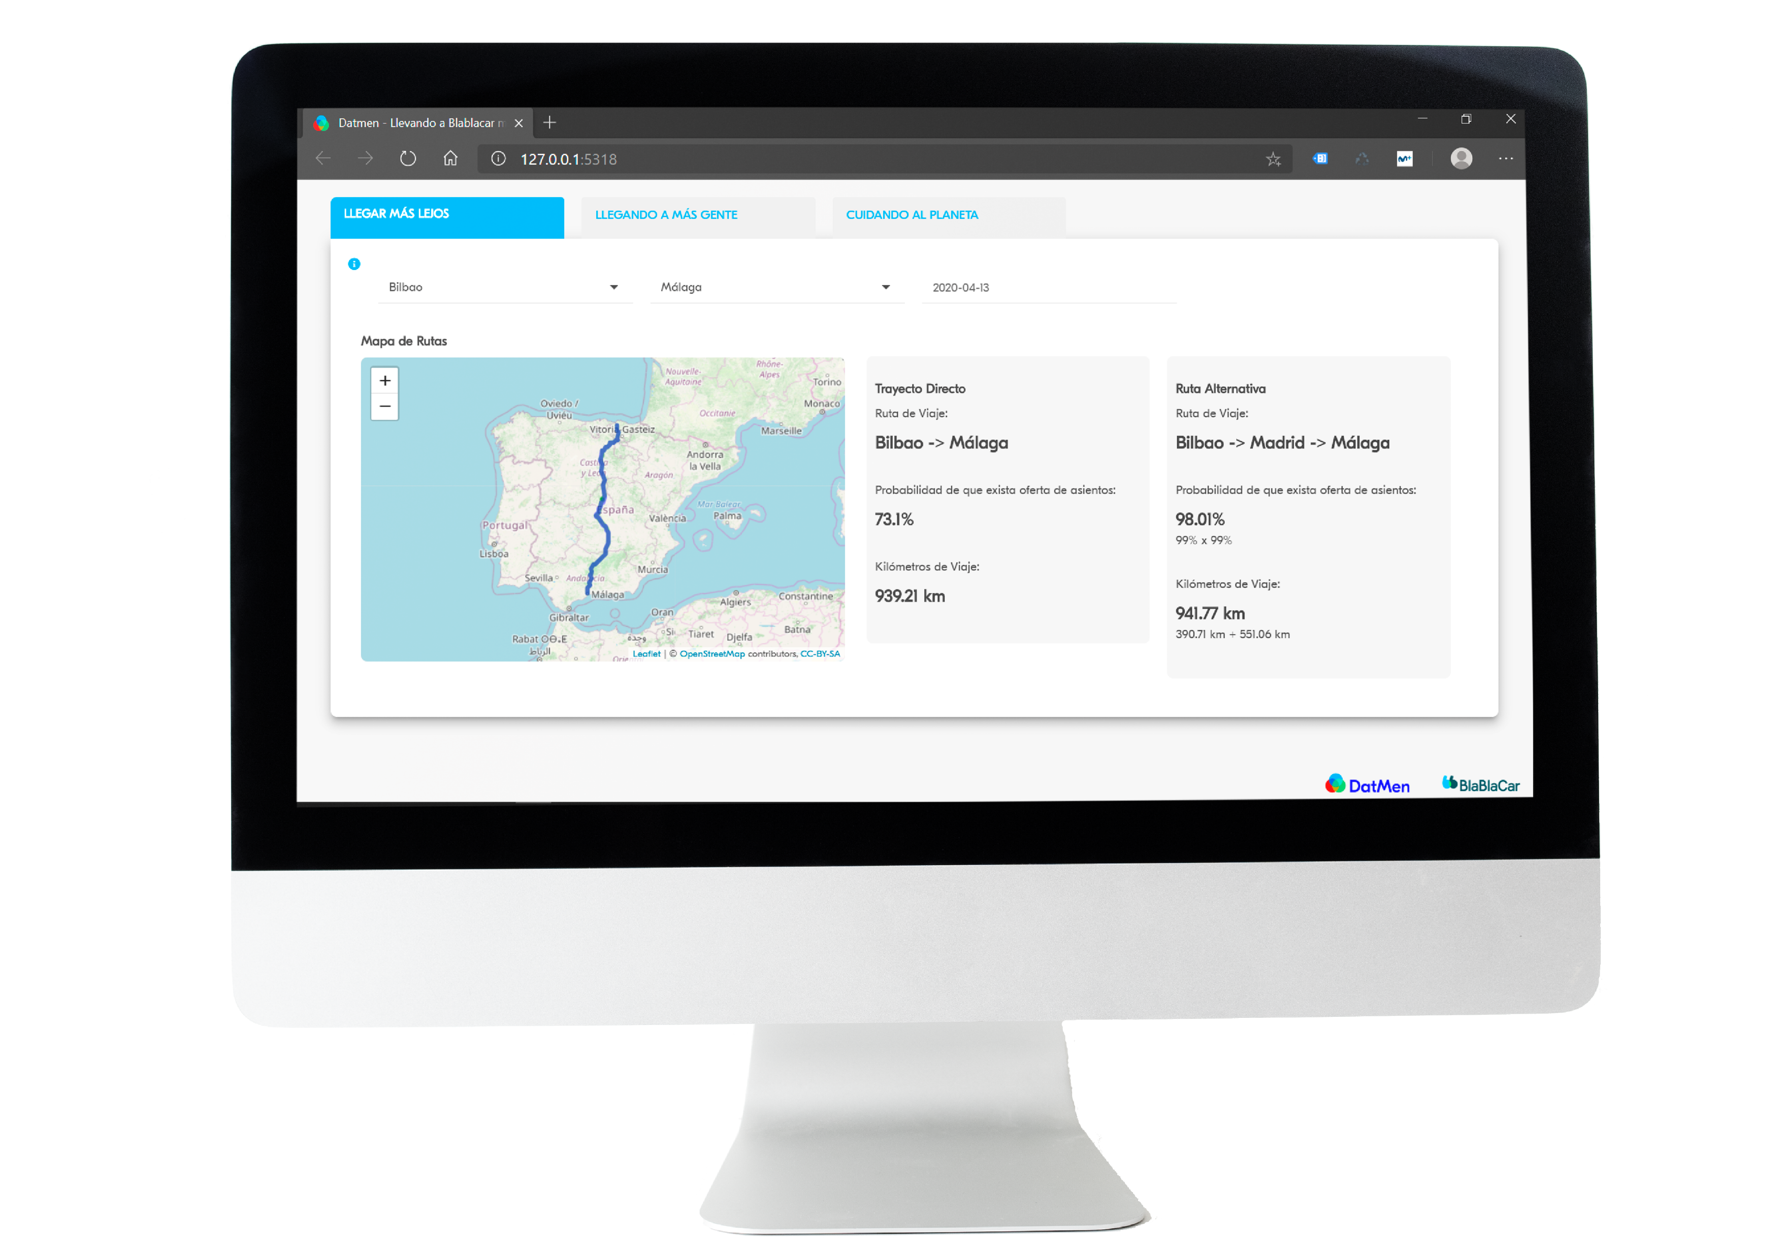
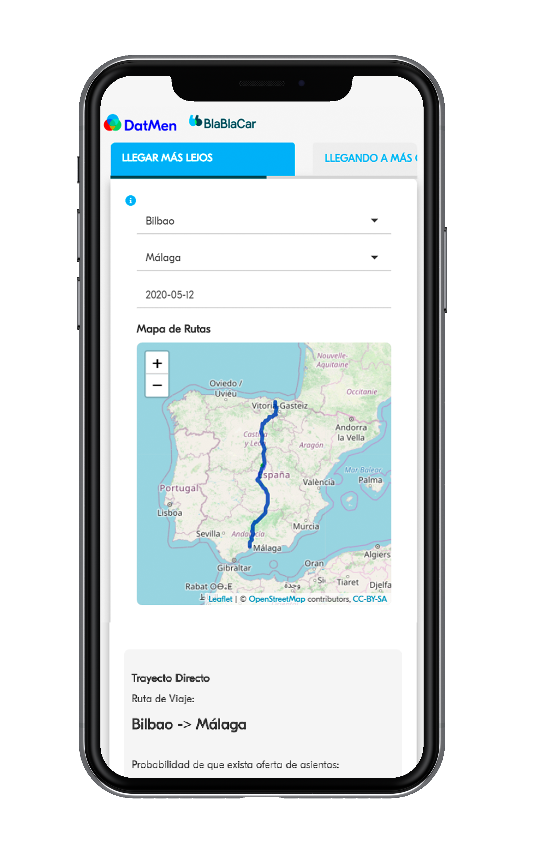
Llegar más lejos
Hay rutas que son poco probables que se den.
Vamos a buscar rutas alternativas cortas y probables

Slide 51
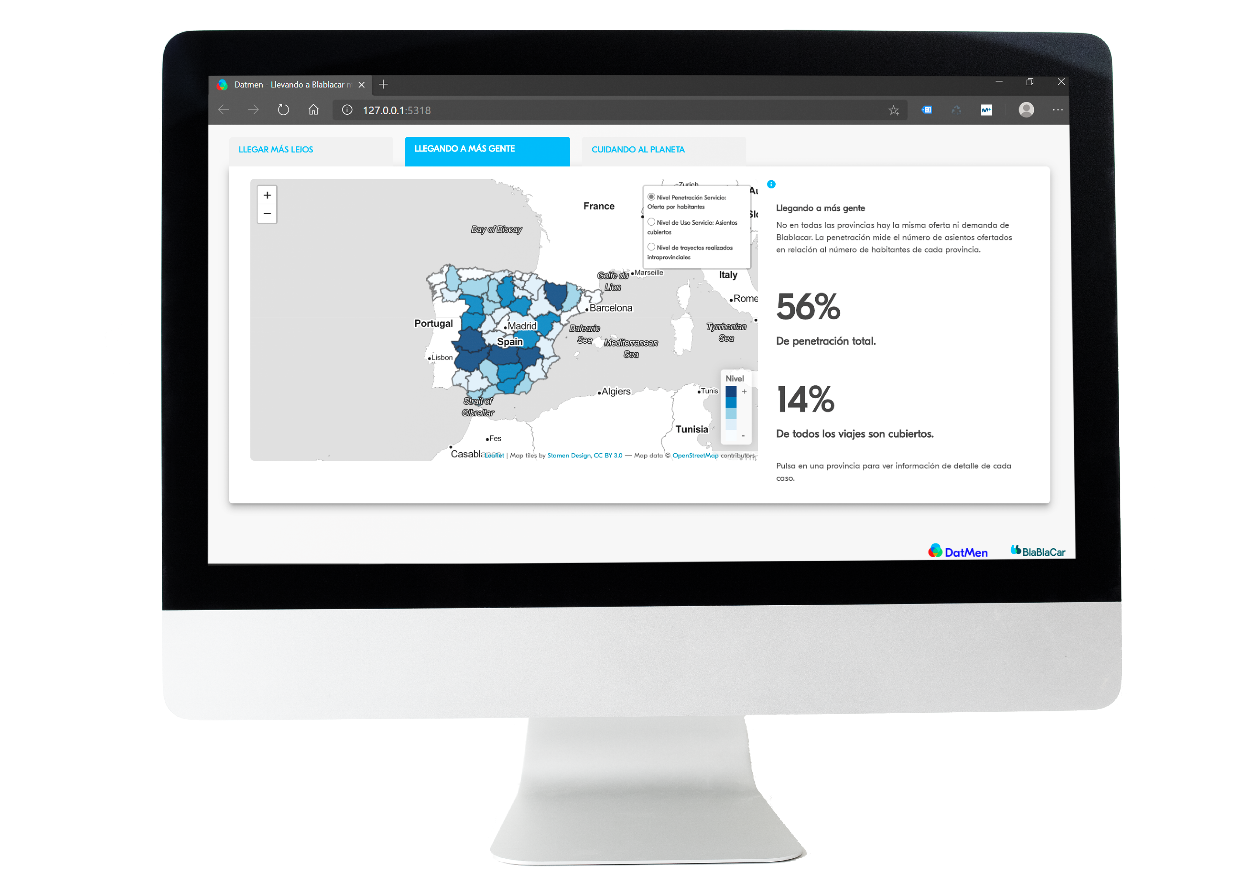
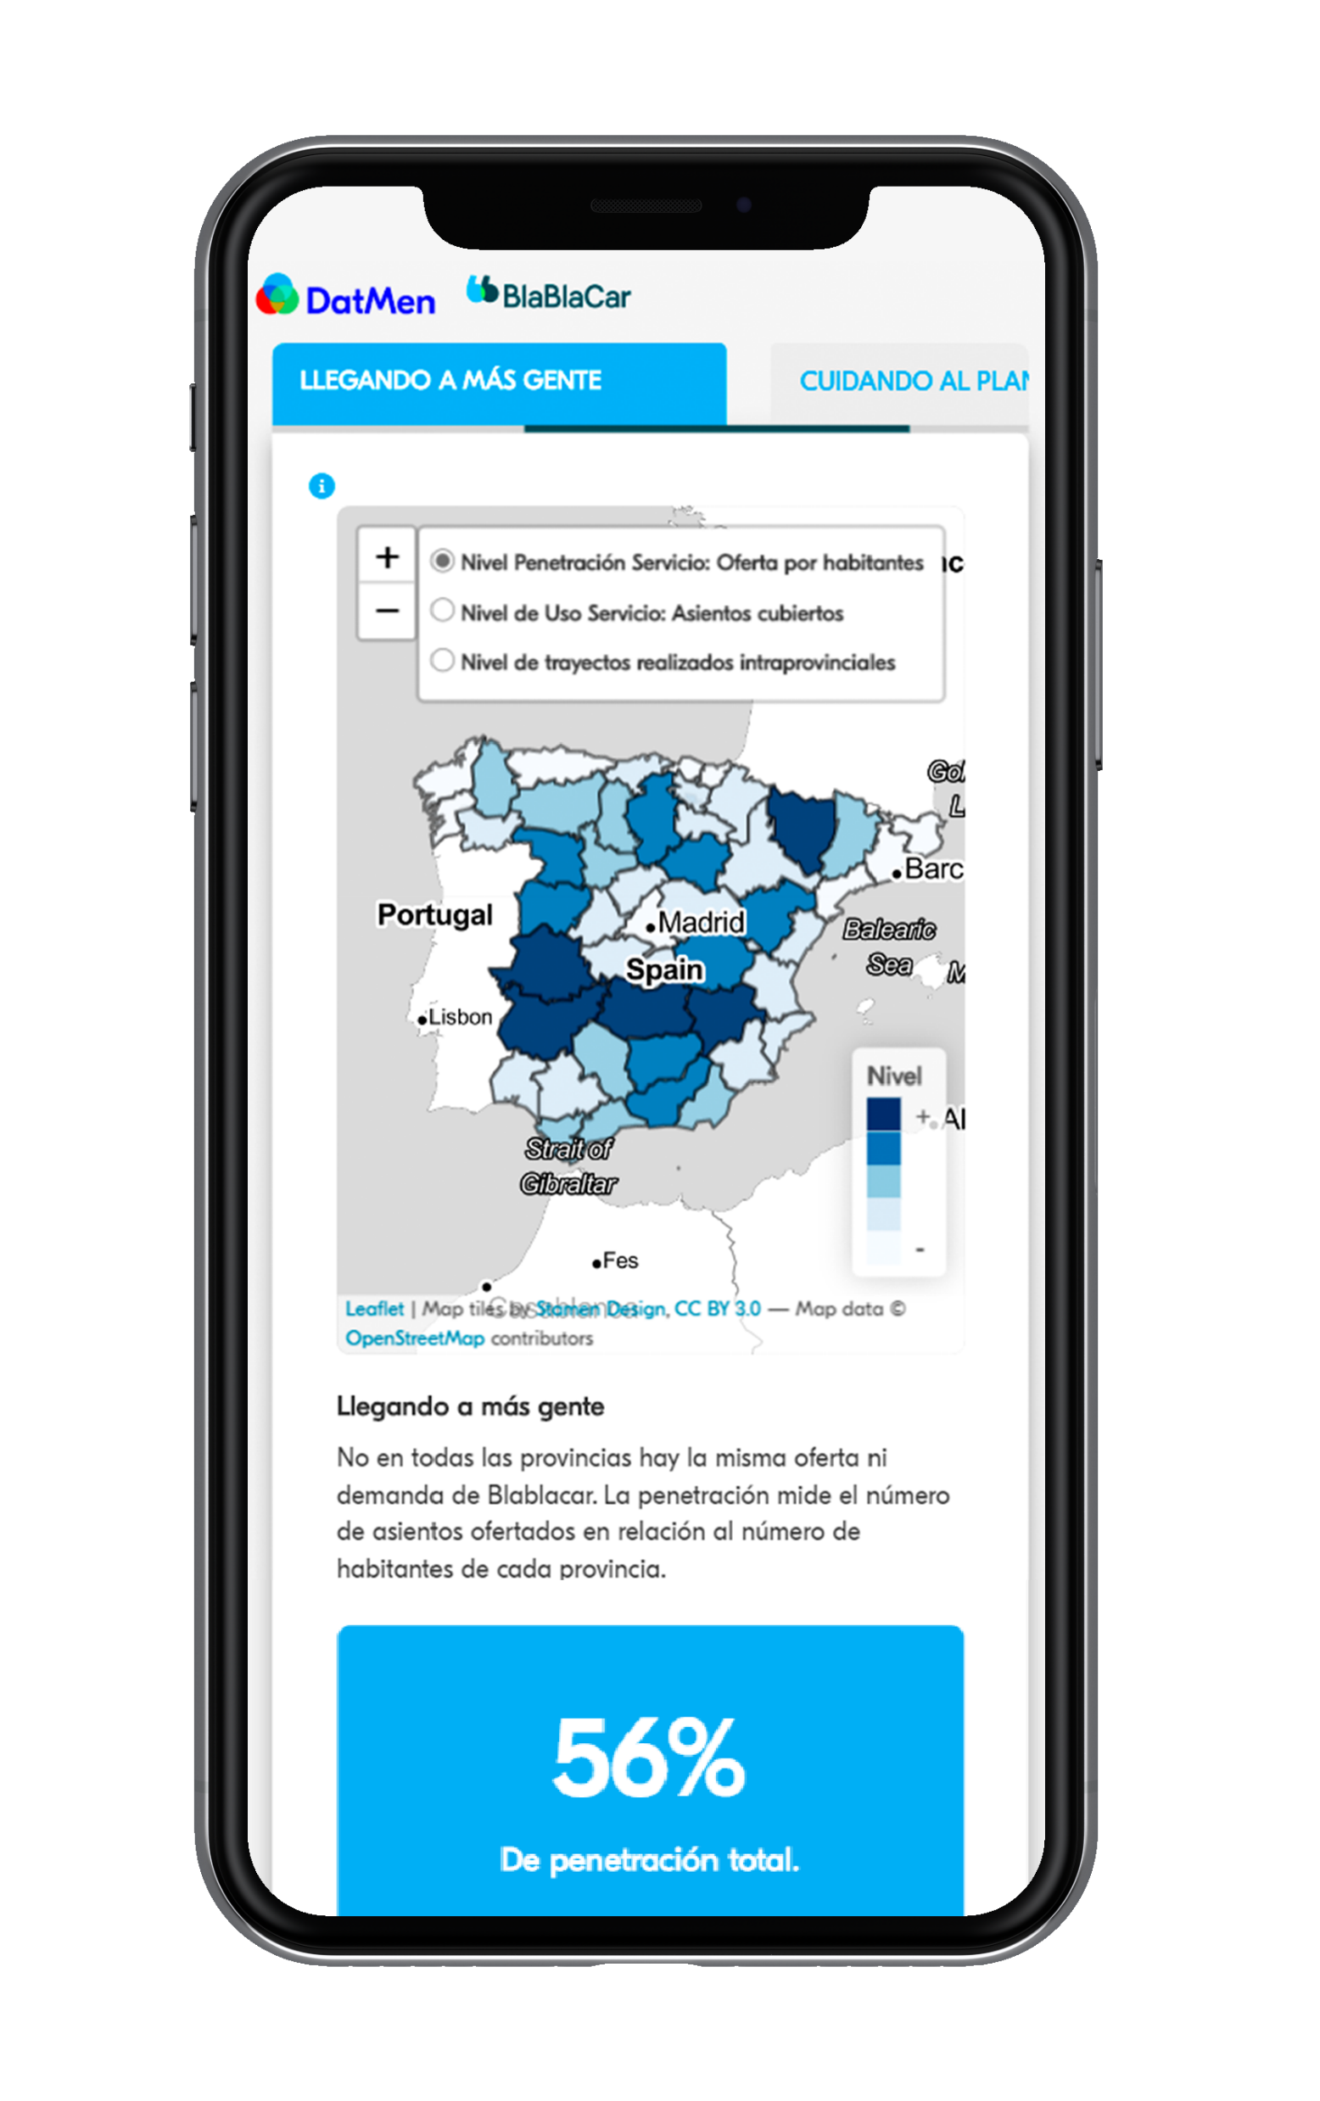
Llegar a más gente
..pero, ¿cómo y dónde publicito yo este proyecto?
Hemos creado un dashboard para saber la penetración y uso de Blablacar en distintas provincias

Slide 52
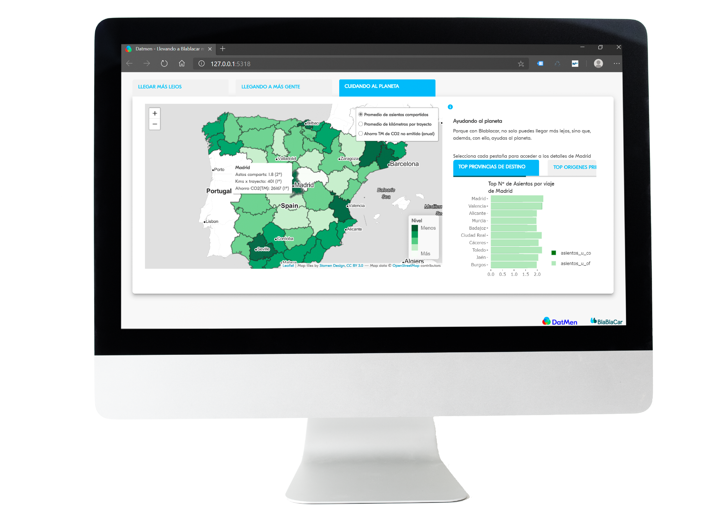
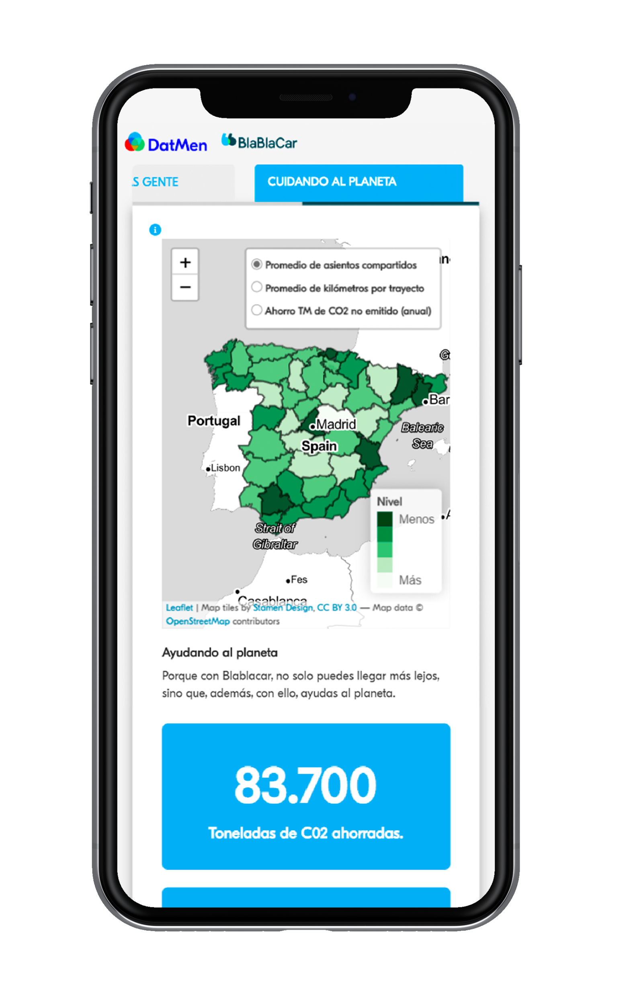
Cuidando el planeta
..pero, ¿cómo puedo llegar a esa gente?
Vamos a calcular y promocionar el ahorro ambiental generado para cada localidad

Slide 53

Llegar más lejos, llegar a más gente, cuidando el planeta.
DatMen

